Slide 1
THE PBIS
Film Festival
Showcasing Positivity, Relationships, & Belonging
03.08.2024
Chicago, Illinois

Slide 2
OVERVIEW
NORMS, OBJECTIVES
THE PBIS FILM FESTIVAL
03.08.2024
CHICAGO, ILLINOIS

Slide 3
DETAILS
SUBMISSIONS, CRITERIA
THE PBIS FILM FESTIVAL
03.08.2024
CHICAGO, ILLINOIS

Slide 4
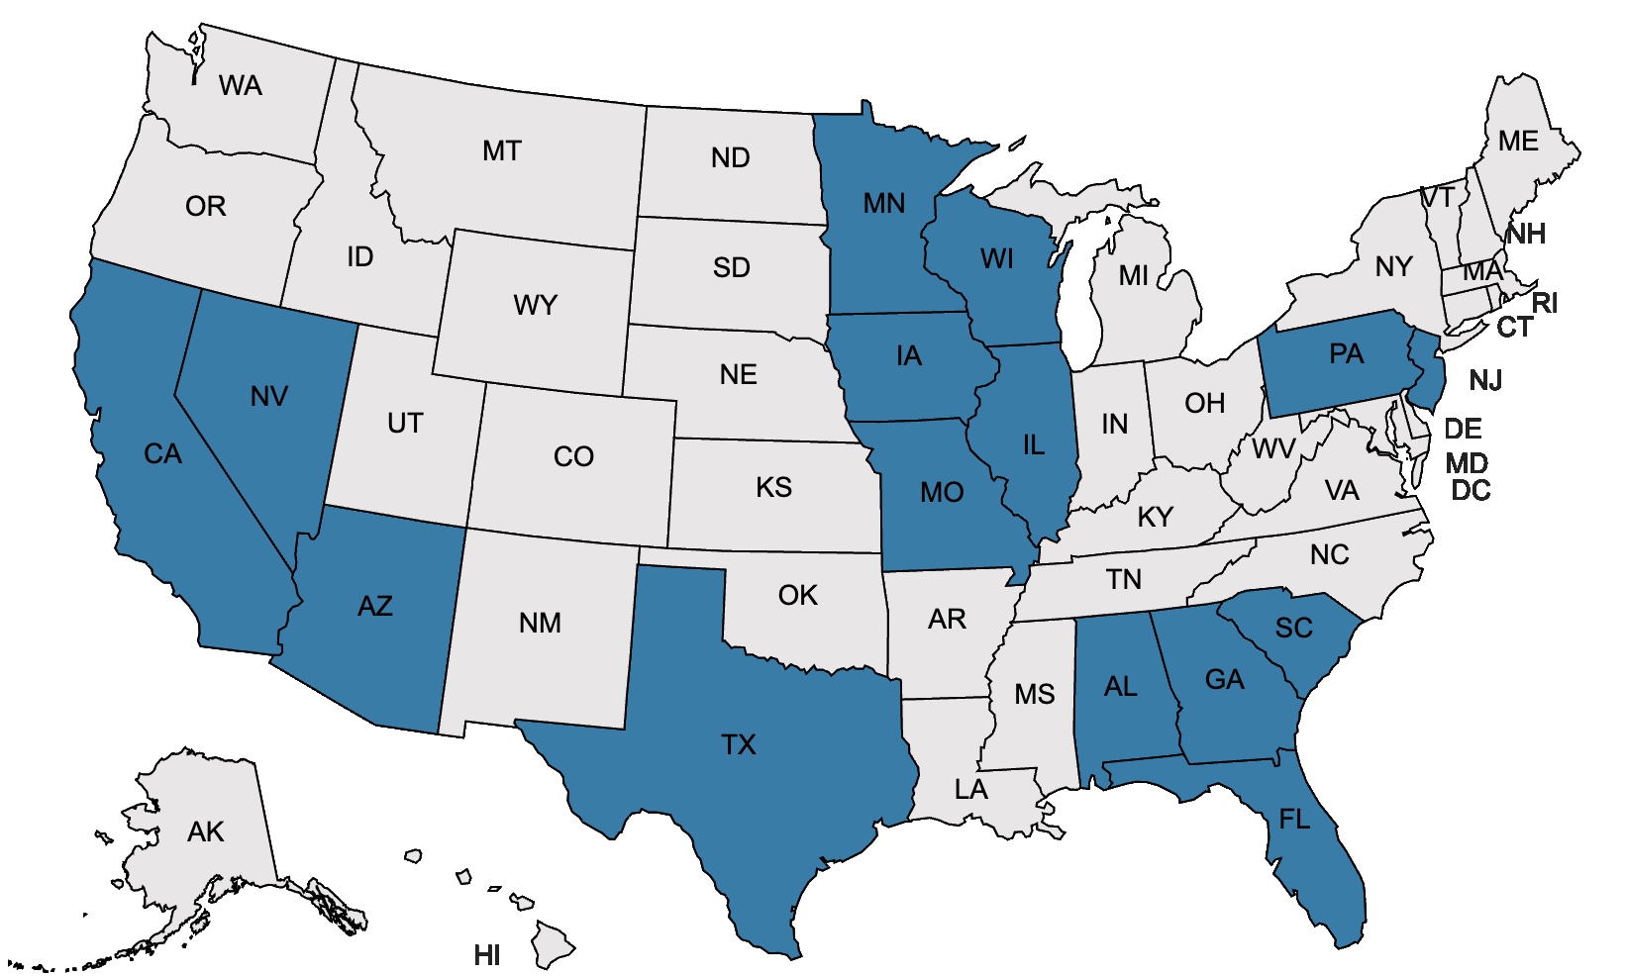
SUBMISSIONS
41 Submissions
15 States
THE PBIS FILM FESTIVAL
03.08.2024
CHICAGO, ILLINOIS

Slide 5
THE CATEGORIES
THE PBIS FILM FESTIVAL
03.08.2024
CHICAGO, ILLINOIS

Slide 6
THE CATEGORIES
Instruction
Elementary/General
High School/Intermediate
School Engagement
Elementary/General
High School/Intermediate
THE PBIS FILM FESTIVAL
03.08.2024
CHICAGO, ILLINOIS

Slide 7
INSTRUCTIONAL RUBRIC
THE PBIS FILM FESTIVAL
03.08.2024
CHICAGO, ILLINOIS

Slide 8
INSTRUCTIONAL RUBRIC
THE PBIS FILM FESTIVAL
03.08.2024
CHICAGO, ILLINOIS

Slide 9
THE FILMS
THE PBIS FILM FESTIVAL
03.08.2024
CHICAGO, ILLINOIS

Slide 10
INSTRUCTION
FIRST PLACE: Yahara Elementary School - DeForest, Wisconsin
SECOND PLACE: Haley Elementary School - Chandler, Arizona
THIRD PLACE: Natoma Station Elementary - Folsom, California
And The Elementary/General Winners Are:
THE PBIS FILM FESTIVAL
03.08.2024
CHICAGO, ILLINOIS

Slide 11
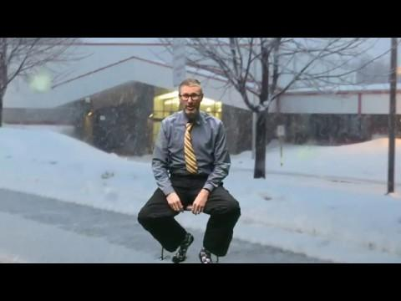
Yahara Elementary School
DeForest, Wisconsin
“It is used to teach and reteach students how to get dressed for recess and what is needed when you go out for recess at Yahara”.
Click The Video Above or See the Speaker Notes for the Video!
THE PBIS FILM FESTIVAL
03.08.2024
CHICAGO, ILLINOIS
Notes:
https://drive.google.com/file/d/1hJg-J7YqB7iFP00MvLlsSrSSwEy5riKk/view?usp=sharing

Slide 12
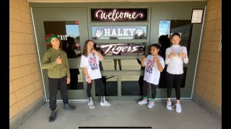
Haley Elementary School Chandler, Arizona
“This was a review of school rules for second semester & we played this video during morning announcements and in the lunchroom during the first week of the semester”.
Click The Video Above or See the Speaker Notes for the Video!
THE PBIS FILM FESTIVAL
03.08.2024
CHICAGO, ILLINOIS
Notes:
https://www.youtube.com/watch?v=dt07AT8NGOA

Slide 13
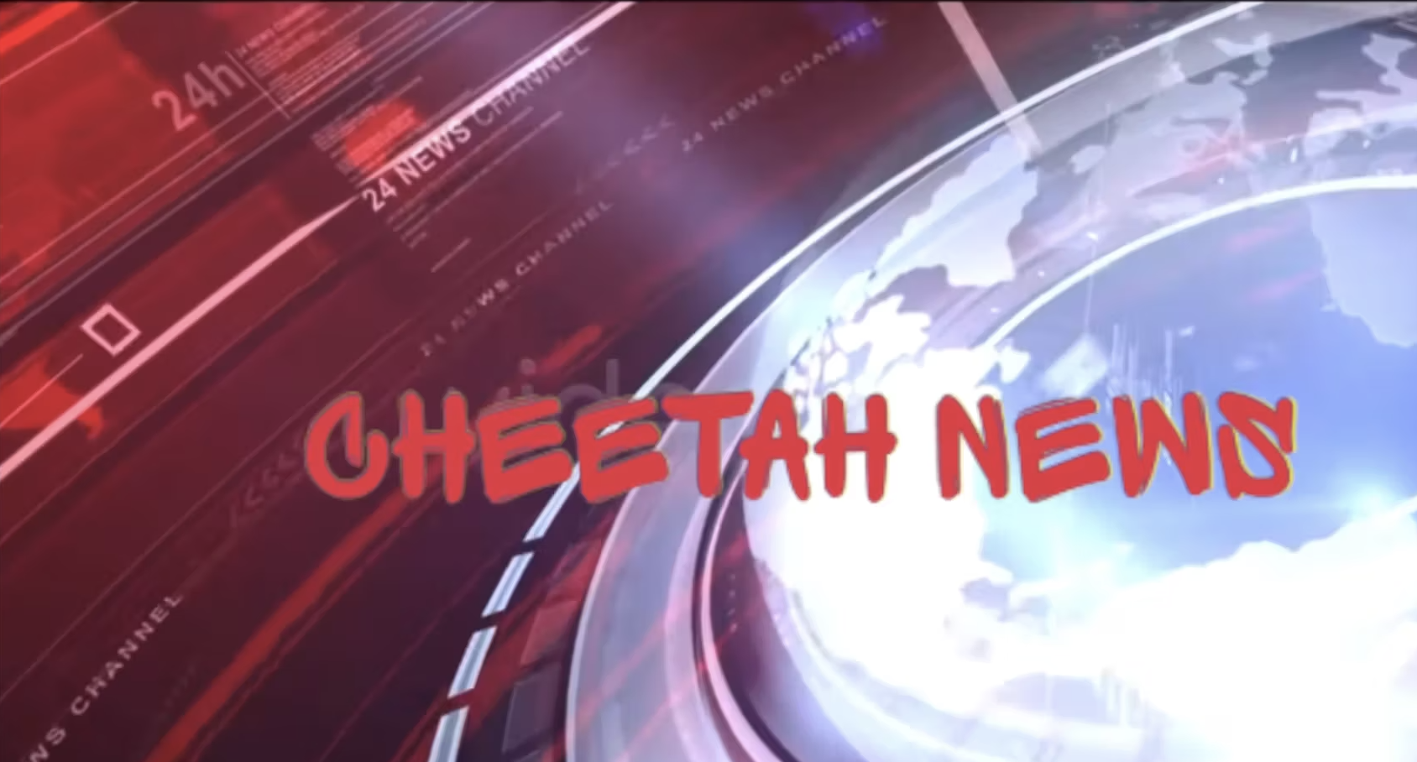
Natoma Station Elementary Folsom, California
“We shared this video on our weekly school newsletter , on our website and each teacher played it in class during our monthly morning message”
Click The Video Above or See the Speaker Notes for the Video!
THE PBIS FILM FESTIVAL
03.08.2024
CHICAGO, ILLINOIS
Notes:
https://vimeo.com/908967579

Slide 14
INSTRUCTION
FIRST PLACE: Santa Ana High School - Santa Ana, California
SECOND PLACE: Princeton Intermediate School - Princeton, Minnesota
THIRD PLACE: Center High School - Kansas City, Missouri
And The Intermediate/High School Winners Are:
THE PBIS FILM FESTIVAL
03.08.2024
CHICAGO, ILLINOIS

Slide 15
Santa Ana High School
Santa Ana, California
“This video was part of our school-wide spring lesson and challenge activity”.
Click The Video Above or See the Speaker Notes for the Video!
THE PBIS FILM FESTIVAL
03.08.2024
CHICAGO, ILLINOIS
Notes:
https://drive.google.com/file/d/1kGHzg3GmIgOjLXTr8pC9xe8br5StFroK/view

Slide 16
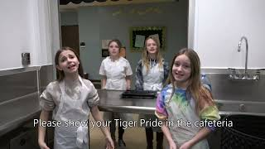
Princeton Intermediate School Princeton, Minnesota
“This video is used to teach and reinforce the proper way to talk milk for breakfast and lunch as well as returning trays properly. The video is shown during a Tiger Pride Newscast and reinforced by teachers”.
Click The Video Above or See the Speaker Notes for the Video!
THE PBIS FILM FESTIVAL
03.08.2024
CHICAGO, ILLINOIS
Notes:
https://www.youtube.com/watch?v=wU8vAqFbmoo

Slide 17
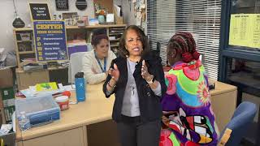
Center High School
Kansas City, Missouri
“This video was shown during Advisory at the beginning of second semester to review expectations. It is also shown to new students during their orientaiton”.
Click The Video Above or See the Speaker Notes for the Video!
THE PBIS FILM FESTIVAL
03.08.2024
CHICAGO, ILLINOIS
Notes:
https://www.youtube.com/watch?v=mjh_hEs6_QI

Slide 18
THE CATEGORIES
Instruction
Elementary/General
High School/Intermediate
School Engagement
Elementary/General
High School/Intermediate
THE PBIS FILM FESTIVAL
03.08.2024
CHICAGO, ILLINOIS

Slide 19
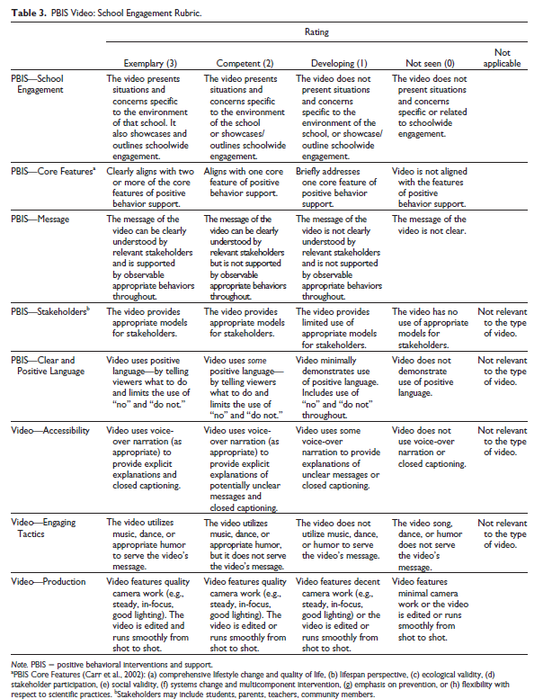
SCHOOL ENGAGEMENT RUBRIC
THE PBIS FILM FESTIVAL
03.08.2024
CHICAGO, ILLINOIS

Slide 20
SCHOOL ENGAGEMENT RUBRIC
THE PBIS FILM FESTIVAL
03.08.2024
CHICAGO, ILLINOIS

Slide 21
THE FILMS
THE PBIS FILM FESTIVAL
03.08.2024
CHICAGO, ILLINOIS

Slide 22
SCHOOL ENGAGEMENT
FIRST PLACE: Berta Weathersbee Elementary - LaGrange, Georgia
SECOND PLACE: Oak Chan Elementary School - Folsom, California
And The Elementary Winners Are:
THE PBIS FILM FESTIVAL
03.08.2024
CHICAGO, ILLINOIS

Slide 23
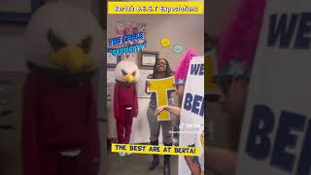
Berta Weathersbee Elementary LaGrange, Georgia
“PBIS Characters Rowdy Robbie and Focused Felicia are headed to the Principal's office to tell him that Rowdie Robbie knows his B.E.S.T. Expectations”.
Click The Video Above or See the Speaker Notes for the Video!
THE PBIS FILM FESTIVAL
03.08.2024
CHICAGO, ILLINOIS
Notes:
https://www.youtube.com/watch?v=vTvhogLt_L0

Slide 24
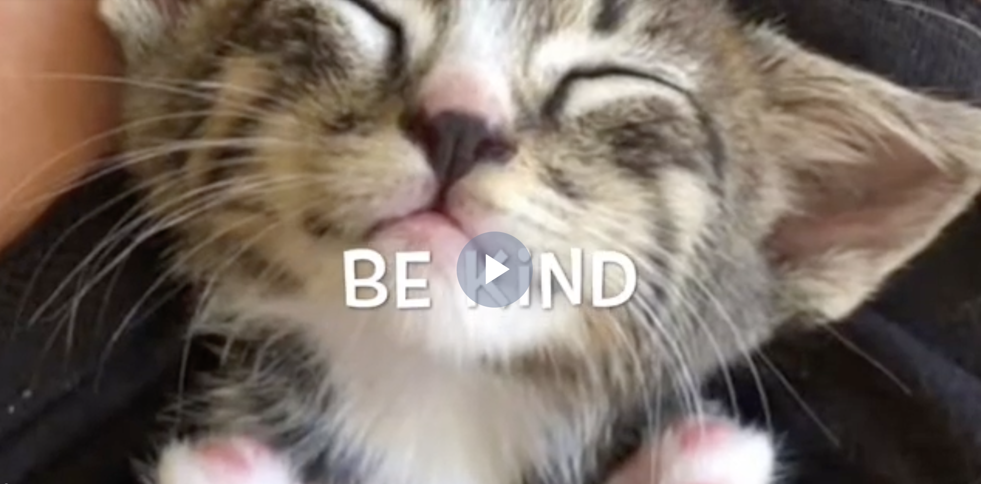
Oak Chan Elementary School Folsom, California
“This video was used to kick off National Kindness Challenge Week of fun activities. Teachers played it in the classroom, a link was sent home to families, and we even enjoyed it during a staff meeting”.
Click The Video Above or See the Speaker Notes for the Video!
THE PBIS FILM FESTIVAL
03.08.2024
CHICAGO, ILLINOIS
Notes:
https://safeshare.tv/x/0oHoPcAfv64

Slide 25
SCHOOL ENGAGEMENT
FIRST PLACE: Grant Community High School, District 124 - Fox Lake, Illinois
SECOND PLACE: Twin Rivers Unified School District – THIRD PLACE: Sacramento, California
THIRD PLACE: Birmingham City Schools - Birmingham, Alabama
And The General/High School Winners Are:
THE PBIS FILM FESTIVAL
03.08.2024
CHICAGO, ILLINOIS

Slide 26
Grant Community High School, District 124
Fox Lake, Illinois
“We show this video se veral times a year to promote positive school culture and reinforce the behavioral expectations on our school-wide matrix”.
Click The Video Above or See the Speaker Notes for the Video!
THE PBIS FILM FESTIVAL
03.08.2024
CHICAGO, ILLINOIS
Notes:
https://www.youtube.com/watch?v=uW9YW4QjXH8

Slide 27
Twin Rivers Unified
School District
Sacramento, California
“We use this film it to motivate, engage, and inspire our staff. We want PBIS to become part of our identity as a district”.
Click The Video Above or See the Speaker Notes for the Video!
THE PBIS FILM FESTIVAL
03.08.2024
CHICAGO, ILLINOIS
Notes:
https://www.youtube.com/watch?v=XzyoeEwEBvo&t=1s

Slide 28
Birmingham City Schools
Birmingham, Alabama
“We showed this video at all of our school’s PBIS pride and activities”.
Click The Video Above or See the Speaker Notes for the Video!
THE PBIS FILM FESTIVAL
03.08.2024
CHICAGO, ILLINOIS
Notes:
https://drive.google.com/file/d/1ojum_2ALRjmQ9ue9HqQn4553b90s77Tu/view

Slide 29
LEARN MORE & SUBMIT NOW!
THE PBIS FILM FESTIVAL
03.08.2024
CHICAGO, ILLINOIS

Slide 30
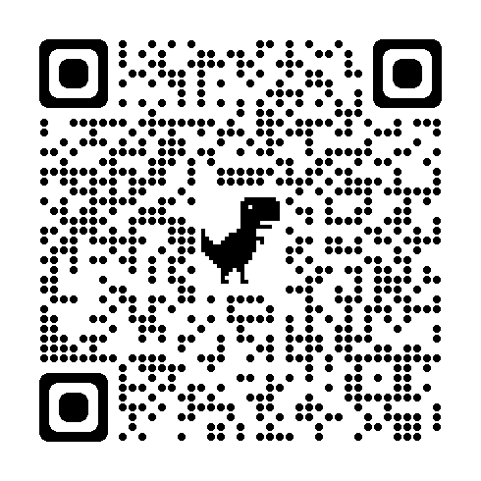
SUBMIT VIDEOS!
www.behavioralliance.org/film-festival/
THE PBIS FILM FESTIVAL
03.08.2024
CHICAGO, ILLINOIS
Notes:
https://drive.google.com/file/d/1ojum_2ALRjmQ9ue9HqQn4553b90s77Tu/view

Slide 31
SEE YOU NEXT YEAR!
Hyatt Regency
St. Louis at the Arch
March 12-15, 2025
www.apbs.org
A PICTURE IS WORTH A THOUSAND WORDS

